Slide 1
Chatbots
By Fahim Uz Zaman
and Alifya

Slide 2
Why?
Daily life usage: checking on weather, schedule, etc.
Get things done: setup alarm/reminder
Easy access to structured data/services: find docs/photos/restaurants
Be more productive in managing your work and personal life.

Slide 3
Chatbots
Two types of chatbots:
Chit-chat Bots:
No Specific goal, focus on natural response
Task-Oriented Bots:
Personal assistant, helps users achieve a certain task.

Slide 4
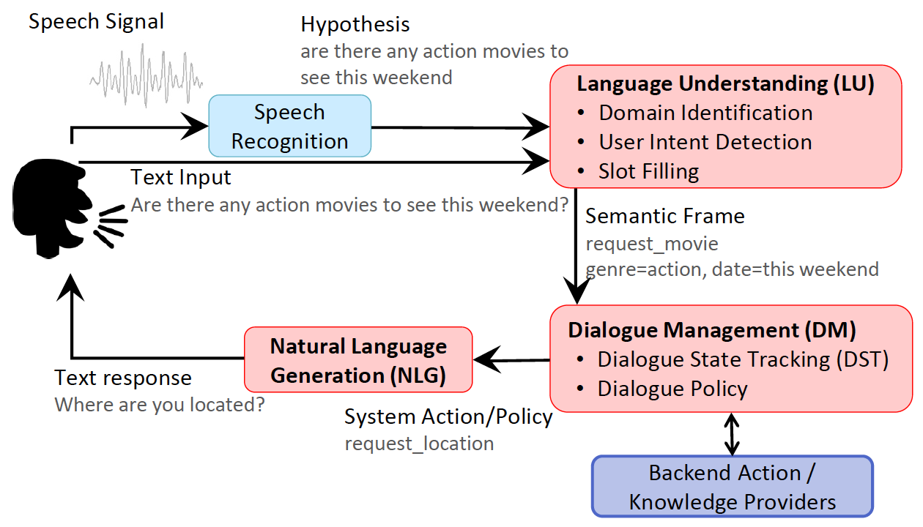
Task-Oriented Chatbots

Slide 5
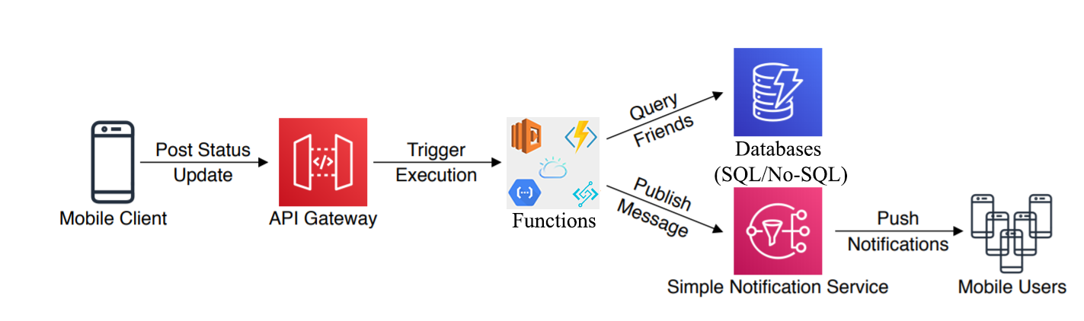
Flow to Serverless Function (Webhook)

Slide 6
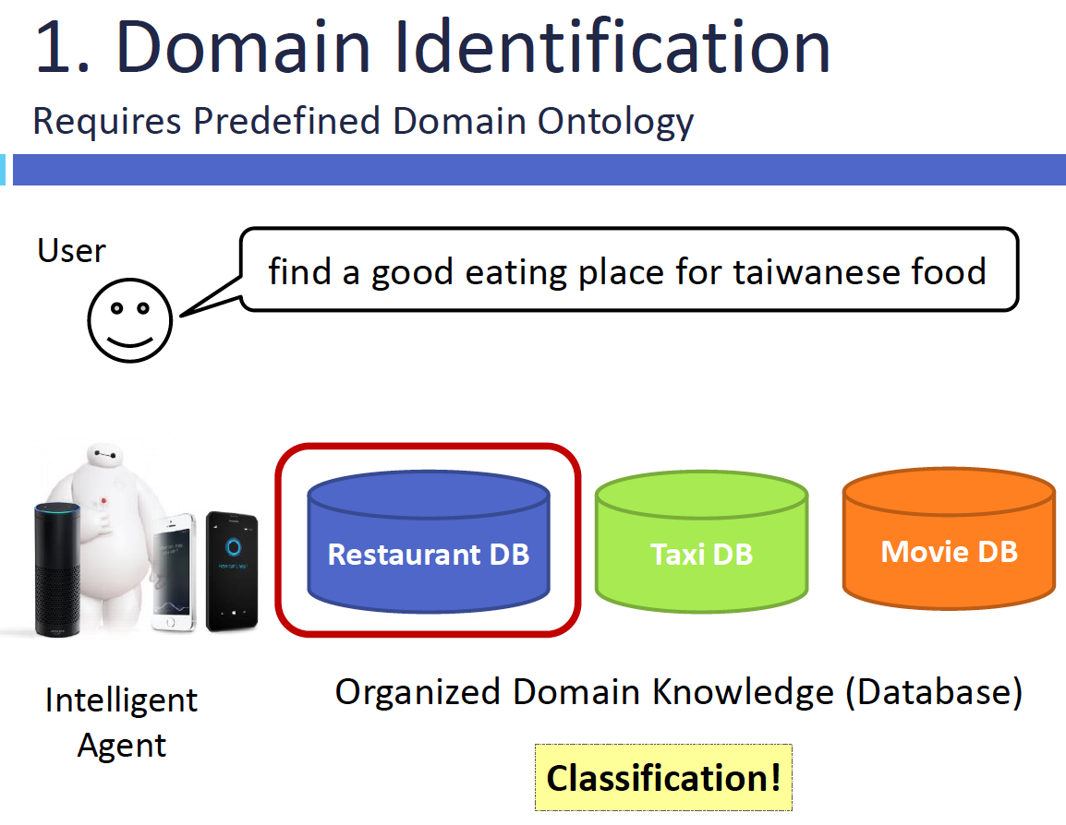
Task-Oriented Chatbots
Source: https://www.slideshare.net/tw_dsconf/ss-75294430

Slide 7
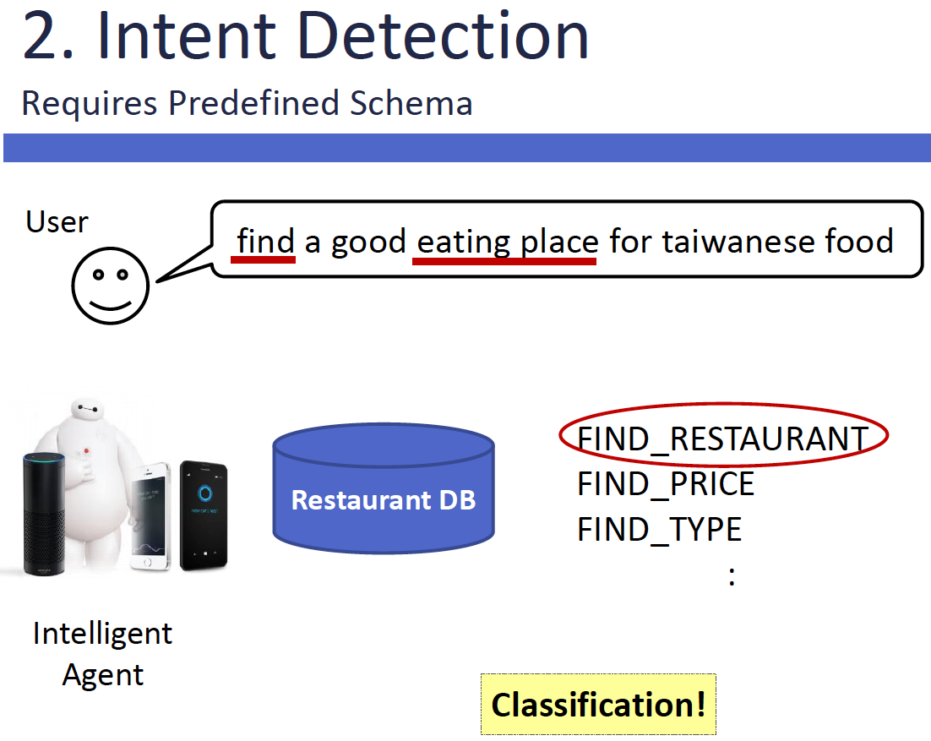
Task-Oriented Chatbots
Source: https://www.slideshare.net/tw_dsconf/ss-75294430

Slide 8
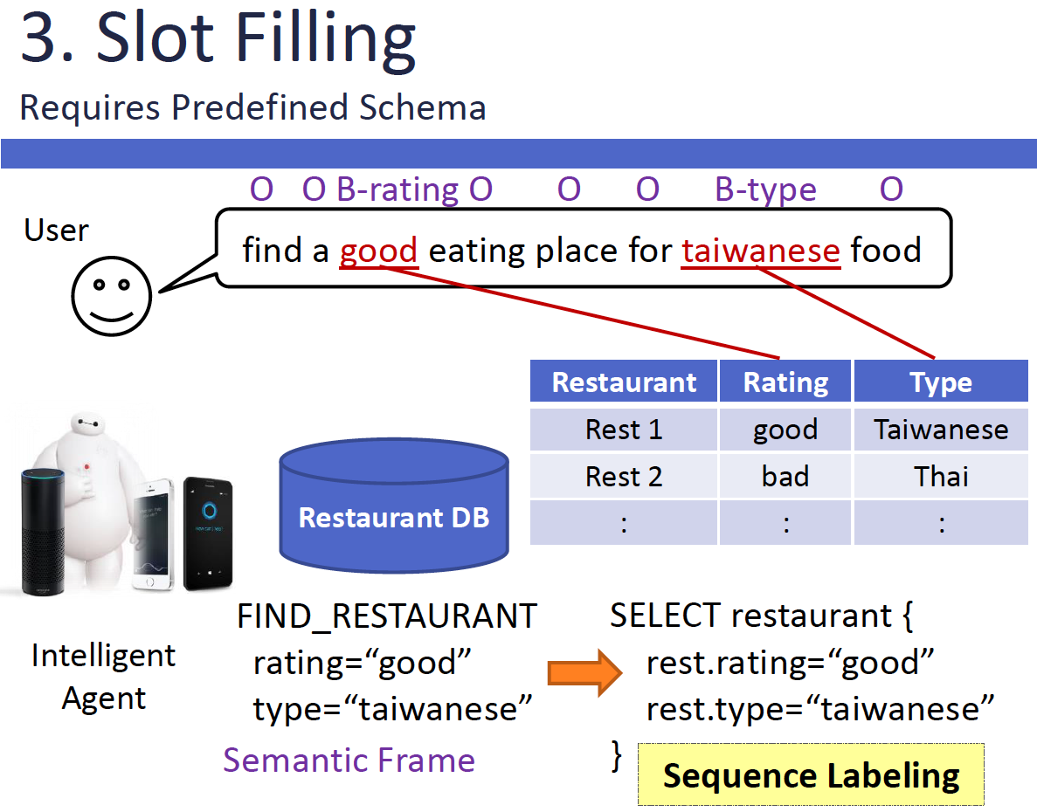
Task-Oriented Chatbots
Source: https://www.slideshare.net/tw_dsconf/ss-75294430

Slide 9

Platforms or Tools
Google Api.ai, is now Dialogflow (sign in with your Google account)
Microsoft LUIS / Power Apps
Facebook Wit.ai
Amazon Lex
Manychat
Chatfuel
Frame-Work:
RASA

Slide 10

Dialogflow
The process a Dialogflow agent follows from invocation to fulfillment is similar to someone answering a question, with some liberties taken

Slide 11
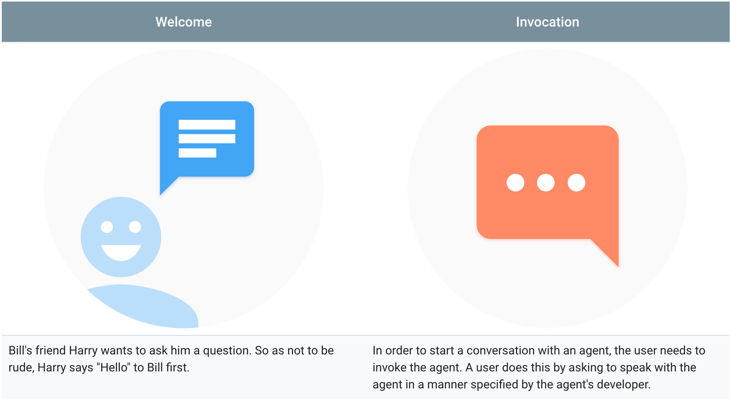
Dialogflow

Slide 12
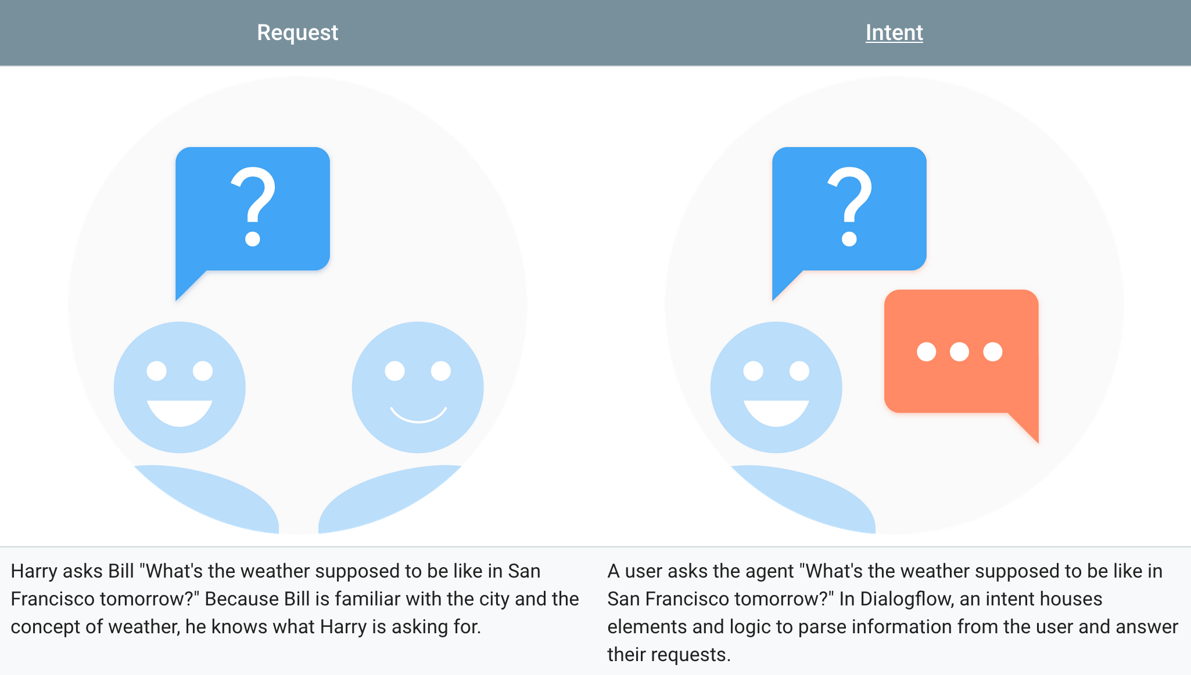
Dialogflow

Slide 13
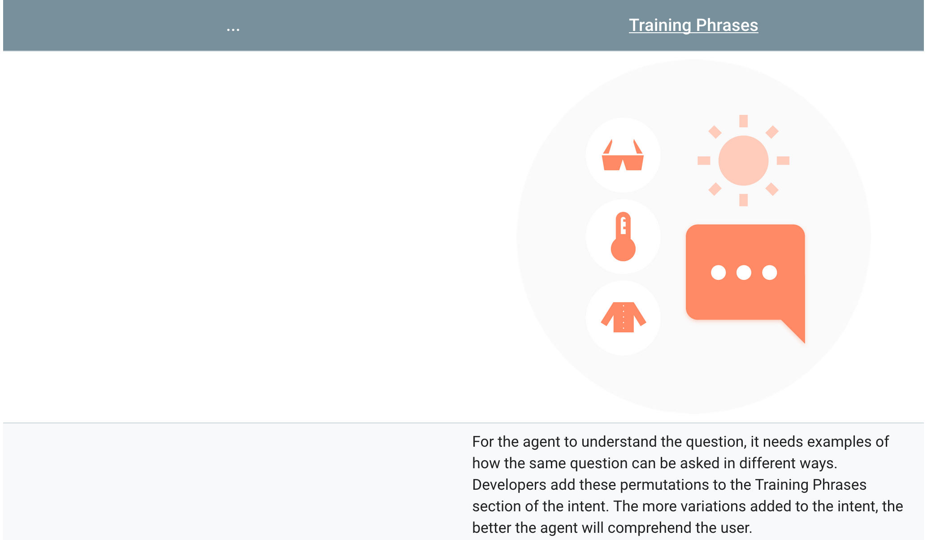
Dialogflow

Slide 14
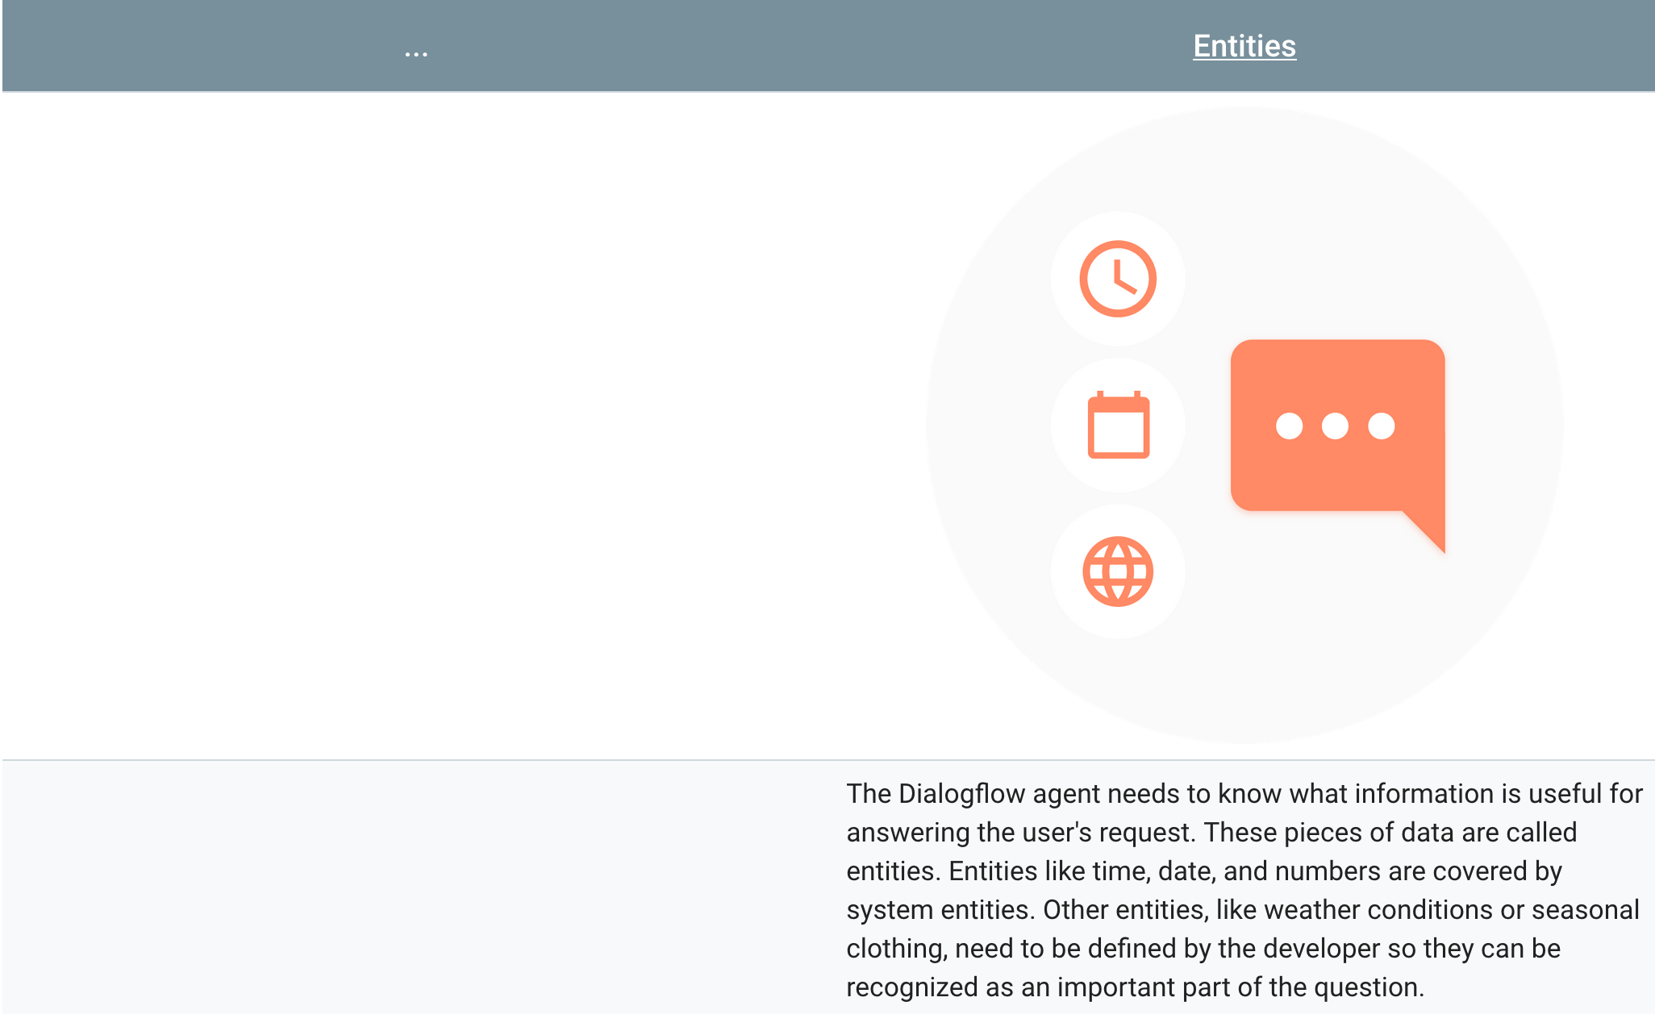
Dialogflow

Slide 15
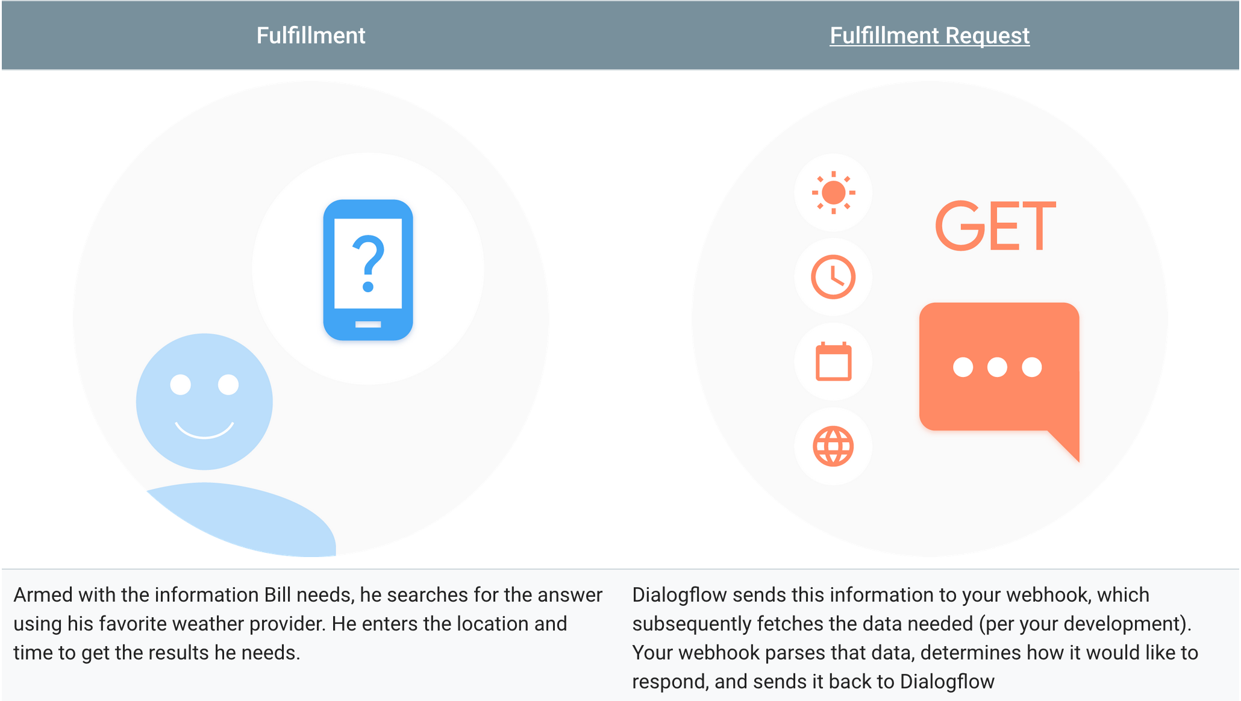
Dialogflow

Slide 16
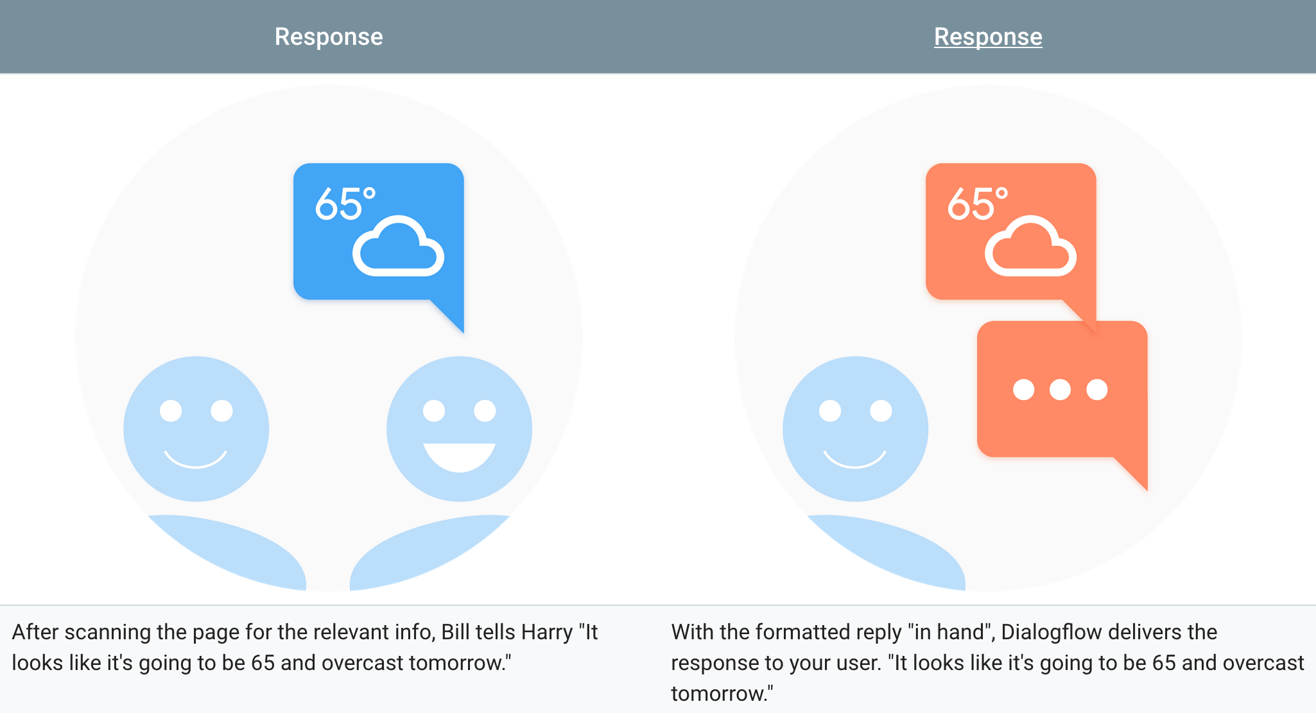
Dialogflow

Slide 17
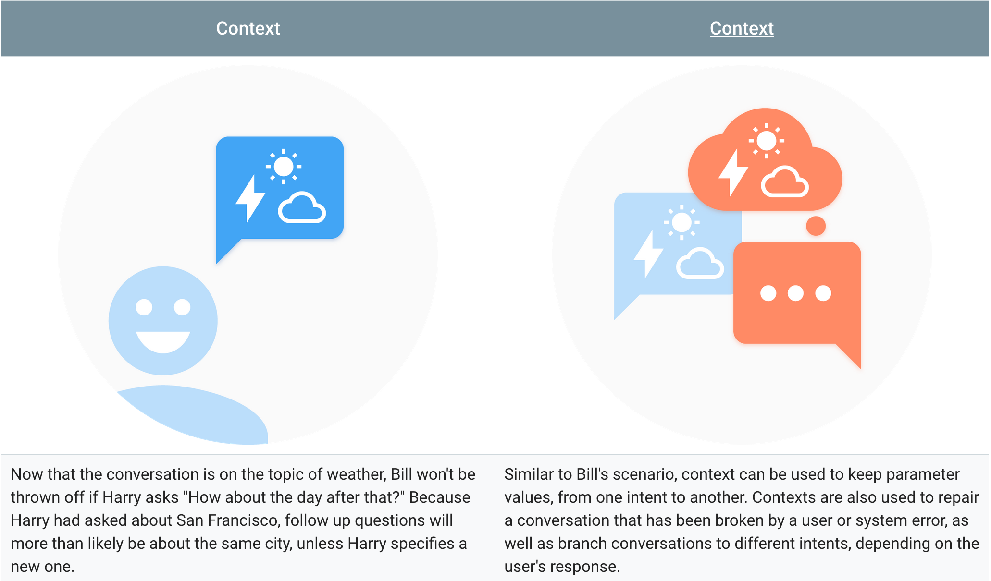
Dialogflow

Slide 18
Dialogflow: 1st agent
Entities
Intents
Responses
For simple replies that don't include information gathered outside of the conversation, you can define the responses directly in the intents. More advanced responses can be made using your own logic and webhook for fulfillment

Slide 19
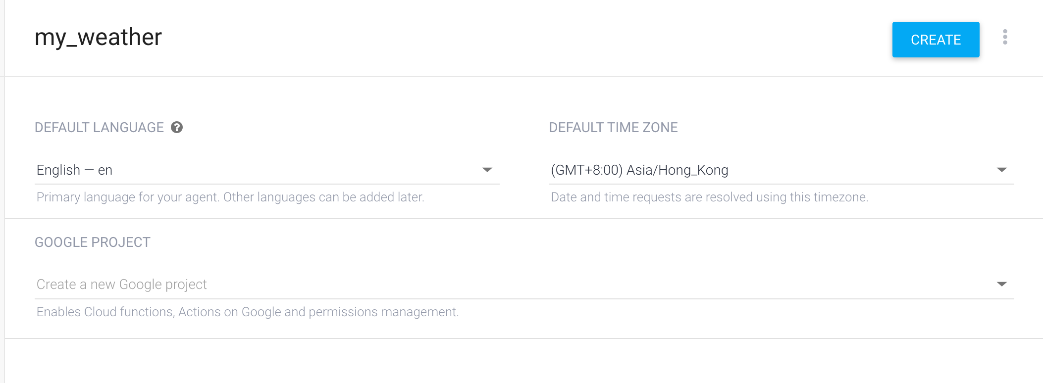
Dialogflow: 1st agent

Slide 20
Create intent
Click on the plus icon ＋ next to Intents.
Enter a name for your intent.
This can be whatever you'd like, but it should be intuitive for what the intent is going to accomplish

Slide 21
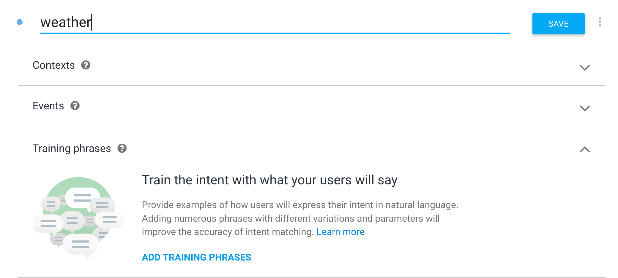
Create intent

Slide 22

Create intent
In the Training Phrases section, enter examples of what you might expect a user to ask for. Since you're creating a weather agent, you want to include questions about locations and different times. The more examples you provide, the more ways a user can ask a question and the agent will understand.
What is the weather like
What is the weather supposed to be
Weather forecast
What is the weather today
Weather for tomorrow
Weather forecast in San Francisco tomorrow

Slide 23
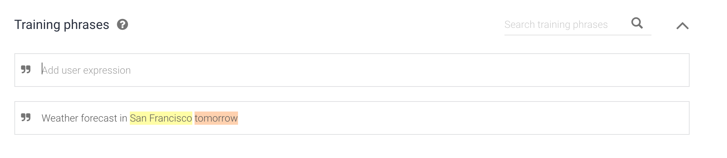
Create intent
training phrases:
Weather forecast in San Francisco tomorrow

Slide 24
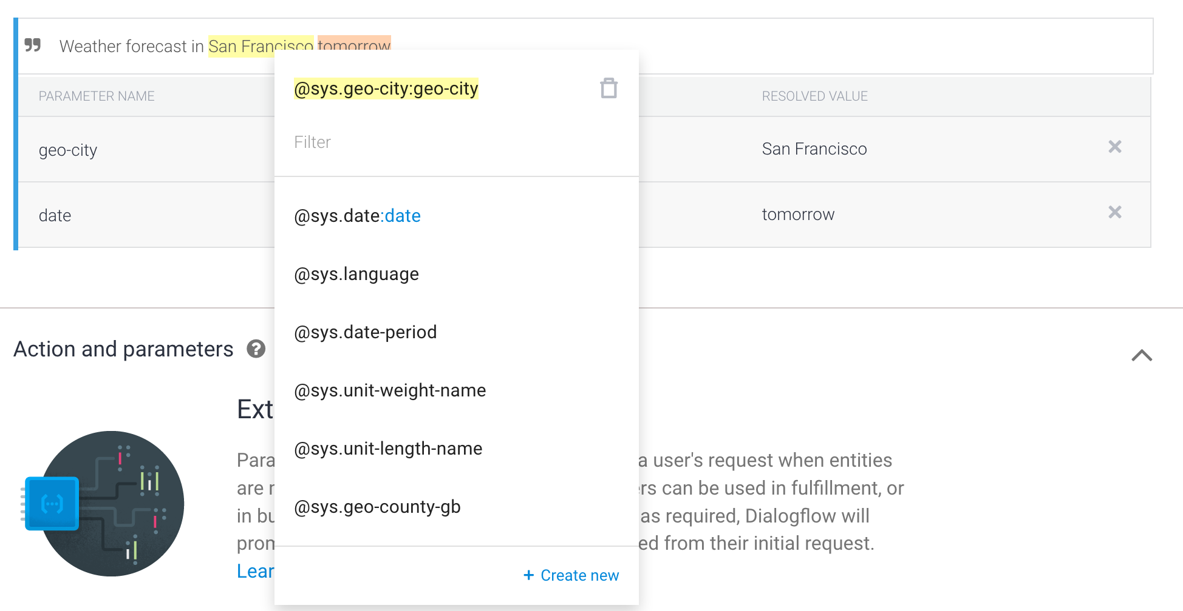
Create intent
Create the system entities, San Francisco tomorrow entities

Slide 25
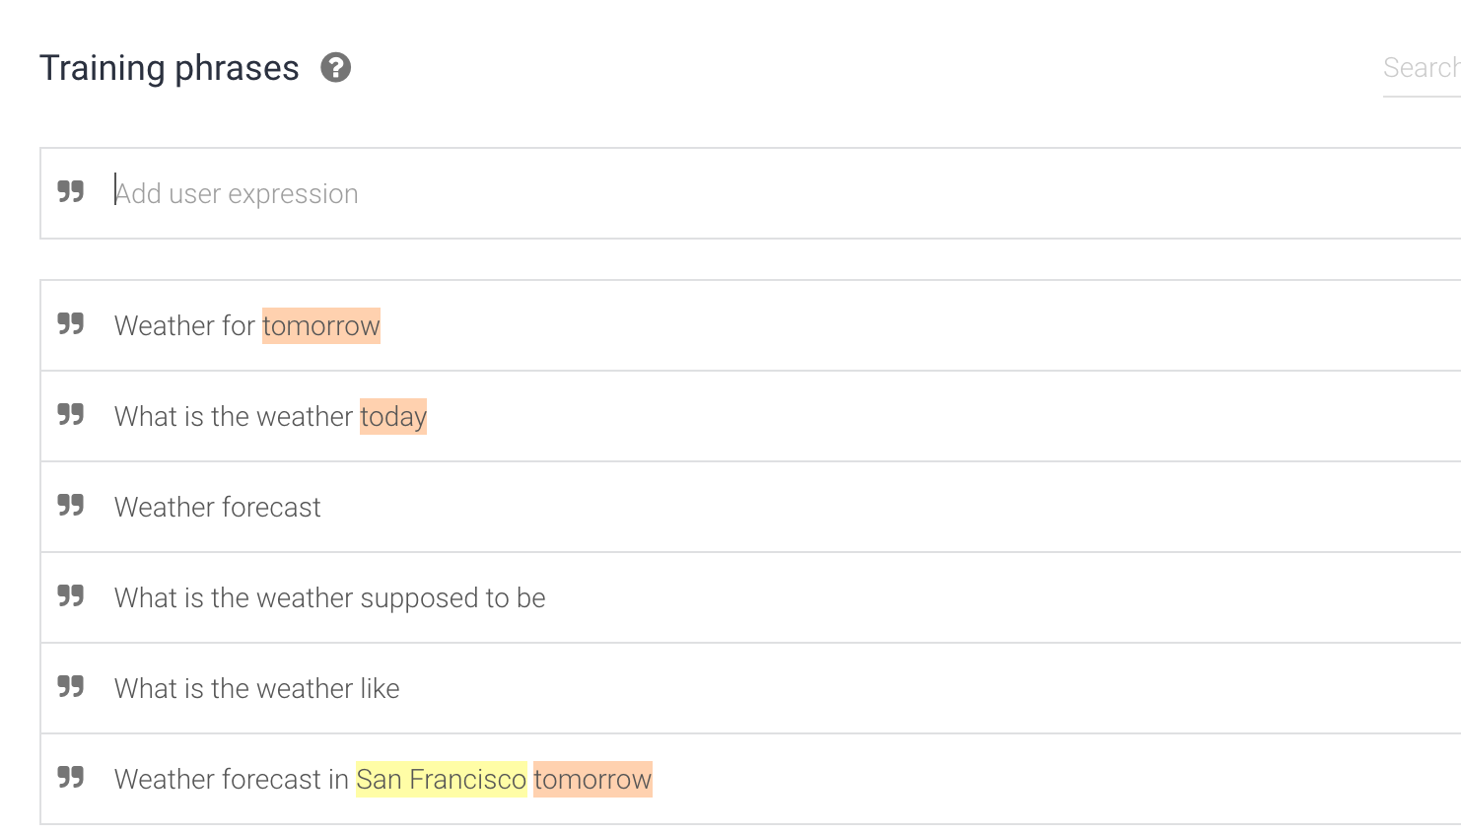
Create intent
training phrases“Save”！

Slide 26
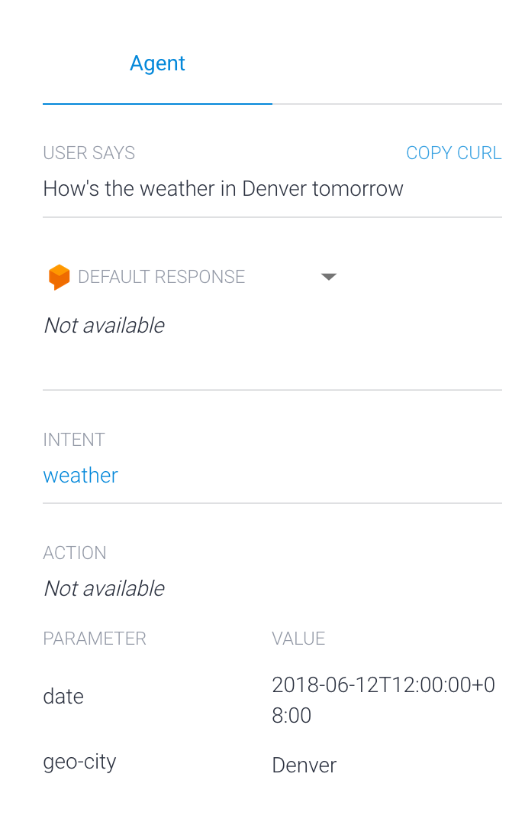
Try it out
Try it now How's the weather in Denver tomorrow

Slide 27
Try it out
You won't get a conversational response, but you should see data in the following fields of the console:
Response - "Not Available" because the agent doesn't have any actual responses set up yet
Intent - weather means the request hit the "weather" intent
Parameters - date and geo-city have their respective values from the request (e.g. tomorrow's date and "Denver")

Slide 28
Add responses
Now you'll add basic responses to the intent so the agent doesn't just sit there in awkward silence.
ADD RESPONSE

Slide 29
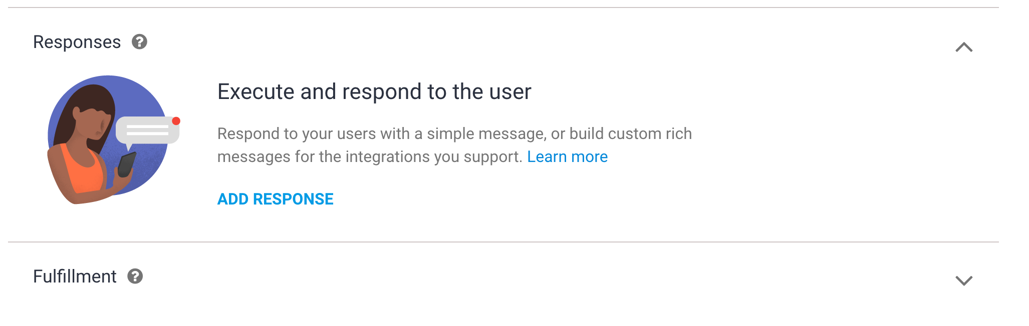
Add responses

Slide 30
Add responses
add the lines of text below in the Response section:
Sorry I don't know the weather
I'm not sure about the weather on $date
I don't know the weather for $date in $geo-city but I hope it's nice!
You can see the last two responses reference entities by their value placeholders. $date will insert the date from the request, and $geo-city will insert the city.

Slide 31
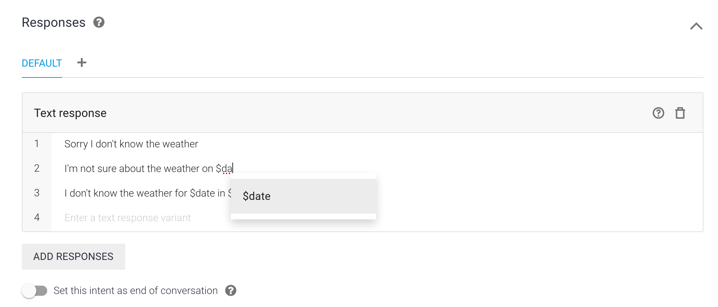
Add responses

Slide 32
Try again
add the lines of text below in the Response section:
Sorry I don't know the weather
I'm not sure about the weather on $date
I don't know the weather for $date in $geo-city but I hope it's nice!
You can see the last two responses reference entities by their value placeholders. $date will insert the date from the request, and $geo-city will insert the city.

Slide 33
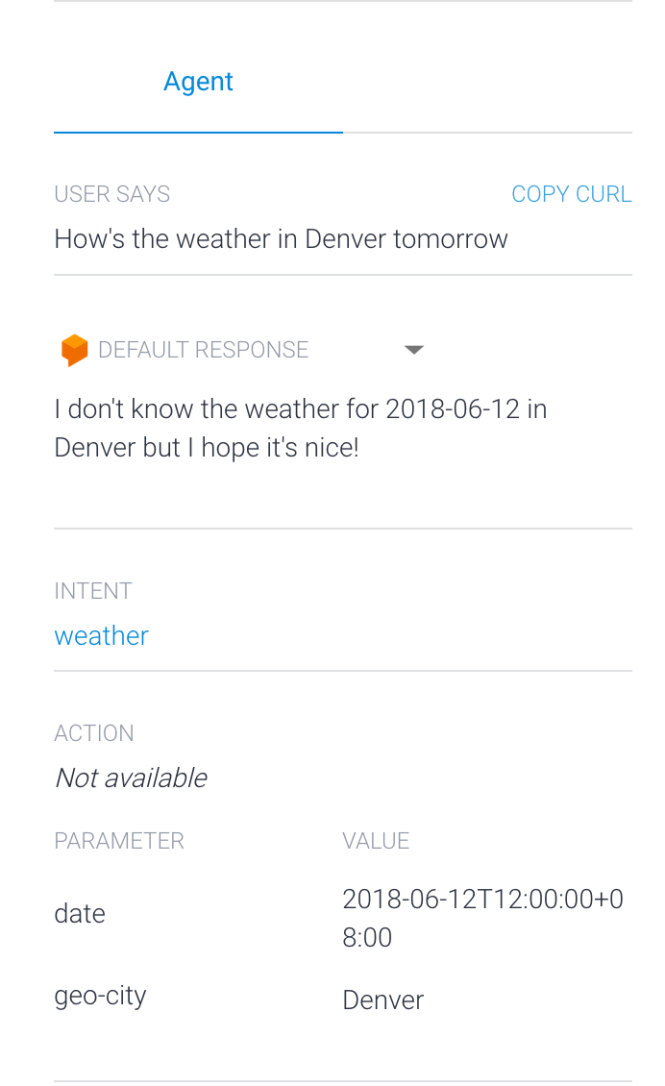
Try again
The response chosen is based off of the values you provide in the query (e.g. By providing only the date, the agent should respond with the option that only includes the date)
How’s the weather tomorrow

Slide 34
Exercise
Enter the first name and last name to response in full name.

Slide 35
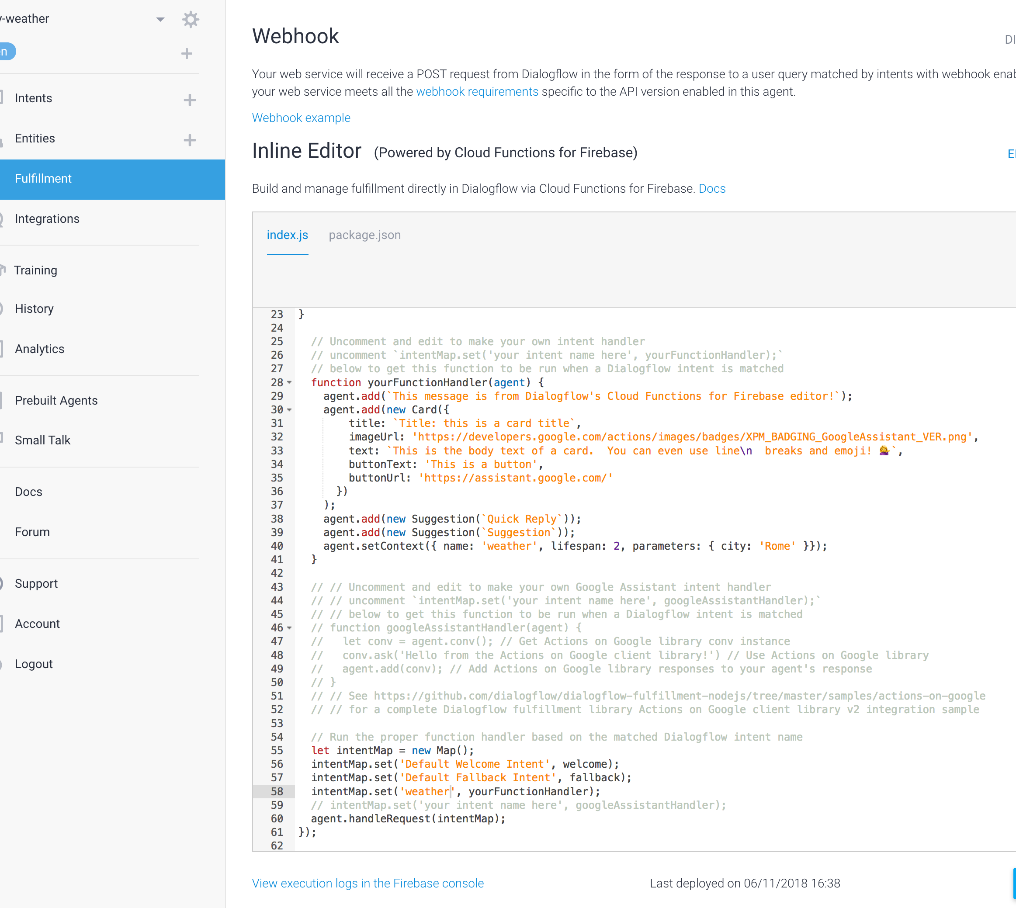
Fullfillment (Webhook)

Slide 36

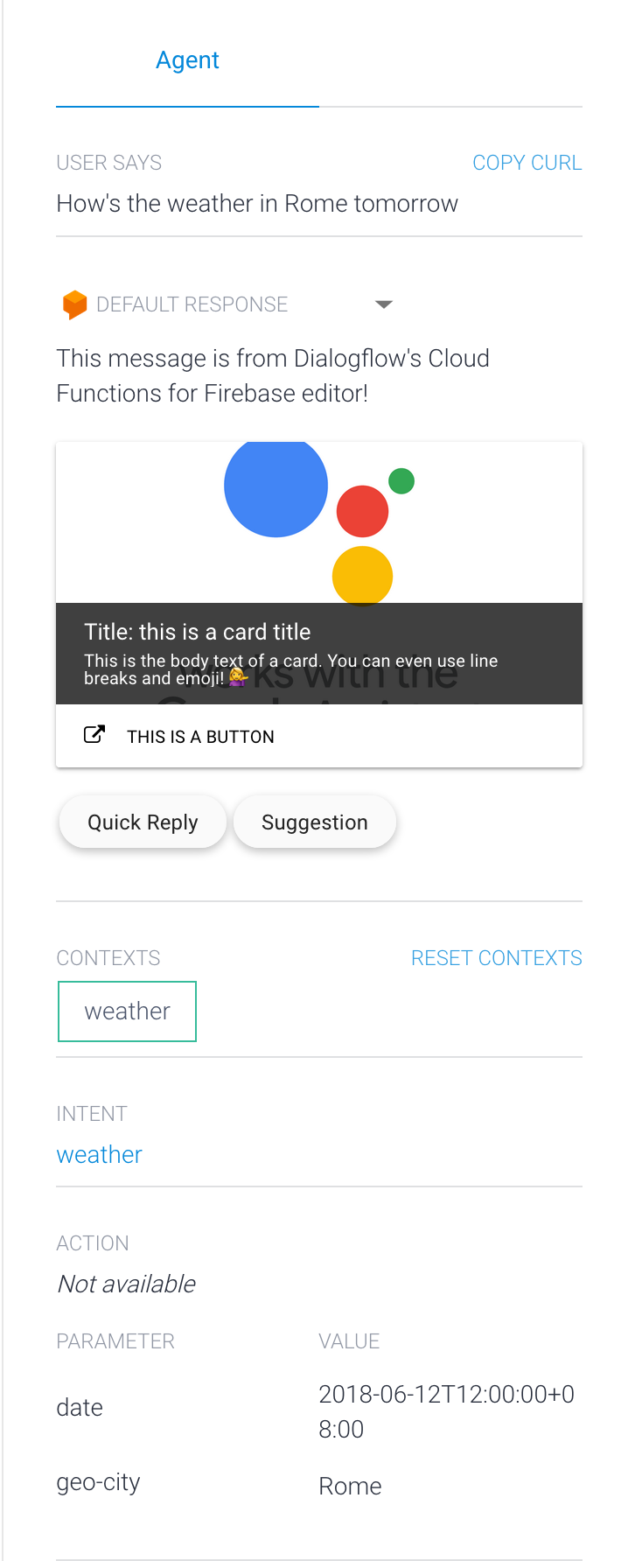
Fullfillment (Webhook)

Slide 37
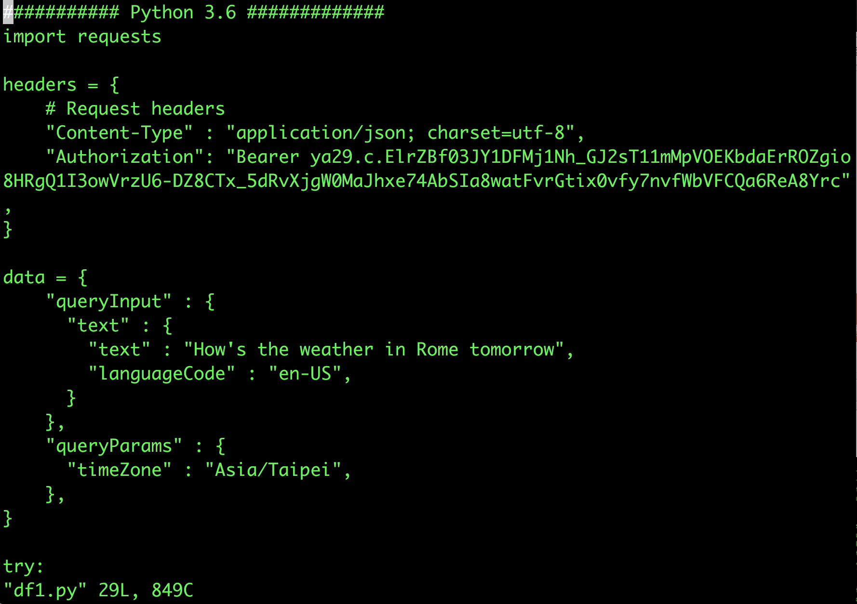
Dialogflow Headers

Slide 38
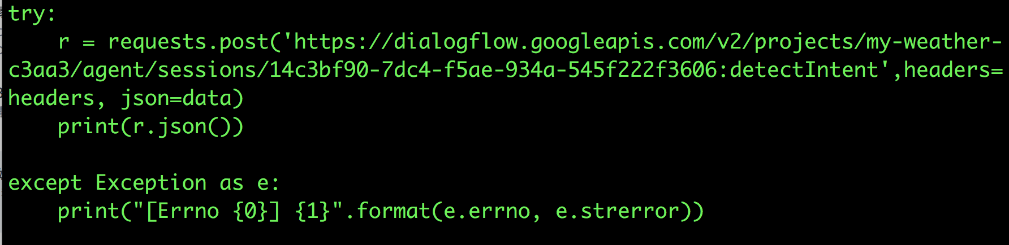
Dialogflow Headers

Slide 39
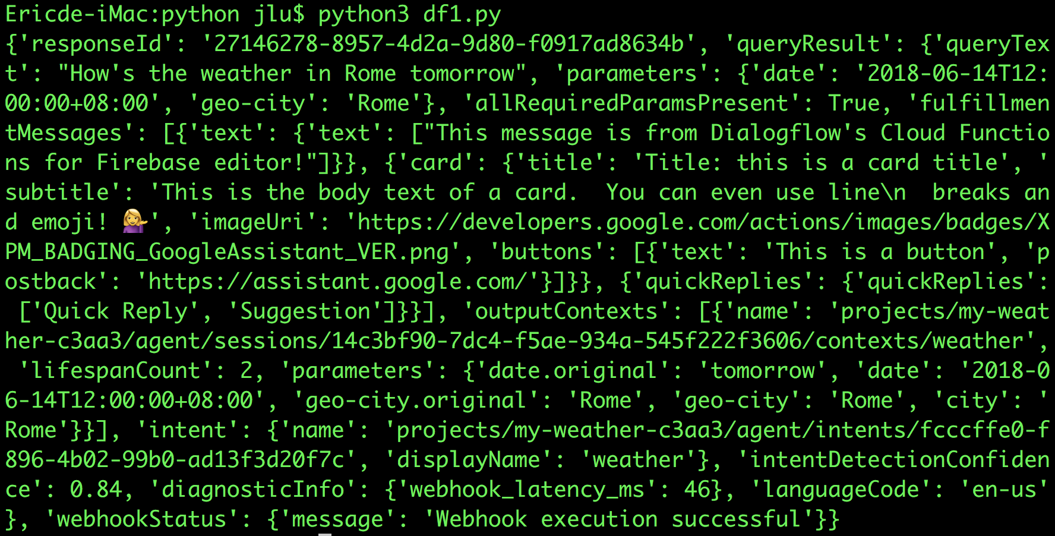
Dialogflow Headers

Slide 40
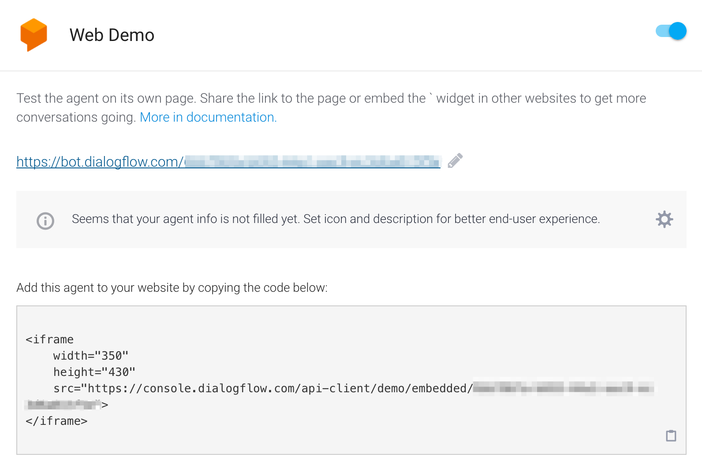
Web Demo

Slide 41
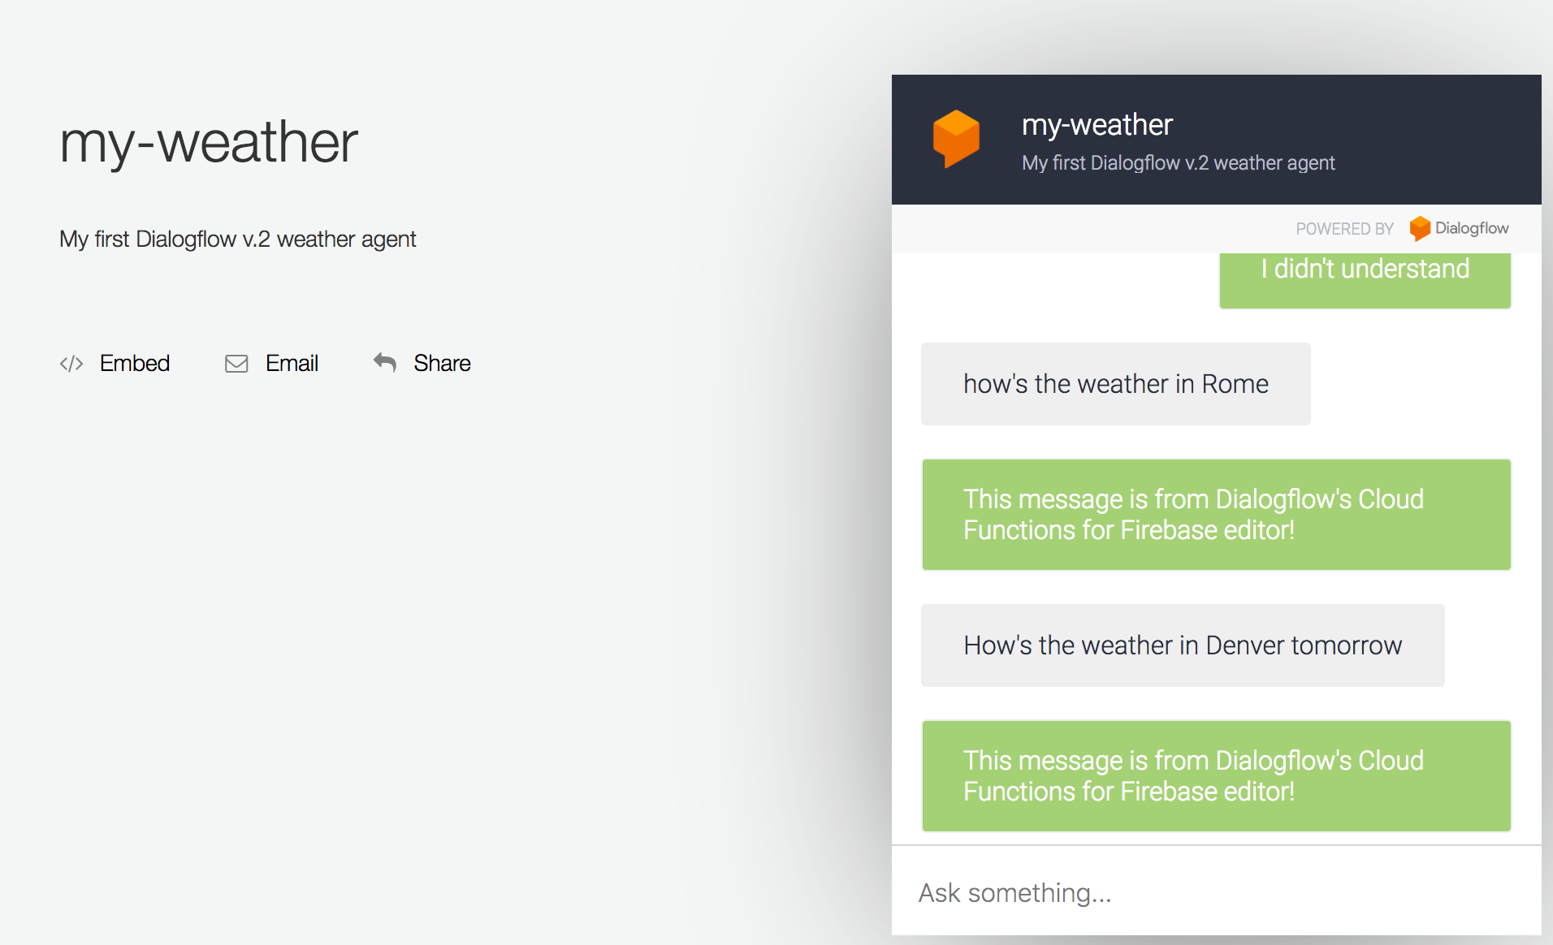
Web Demo

Slide 42
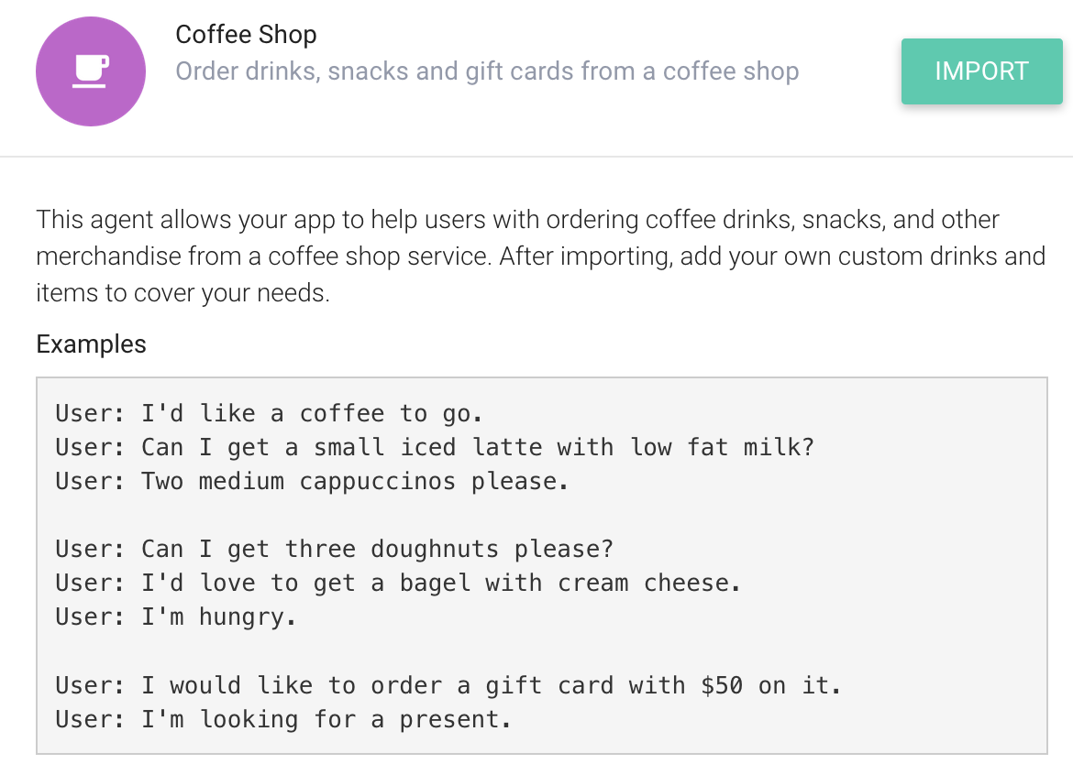
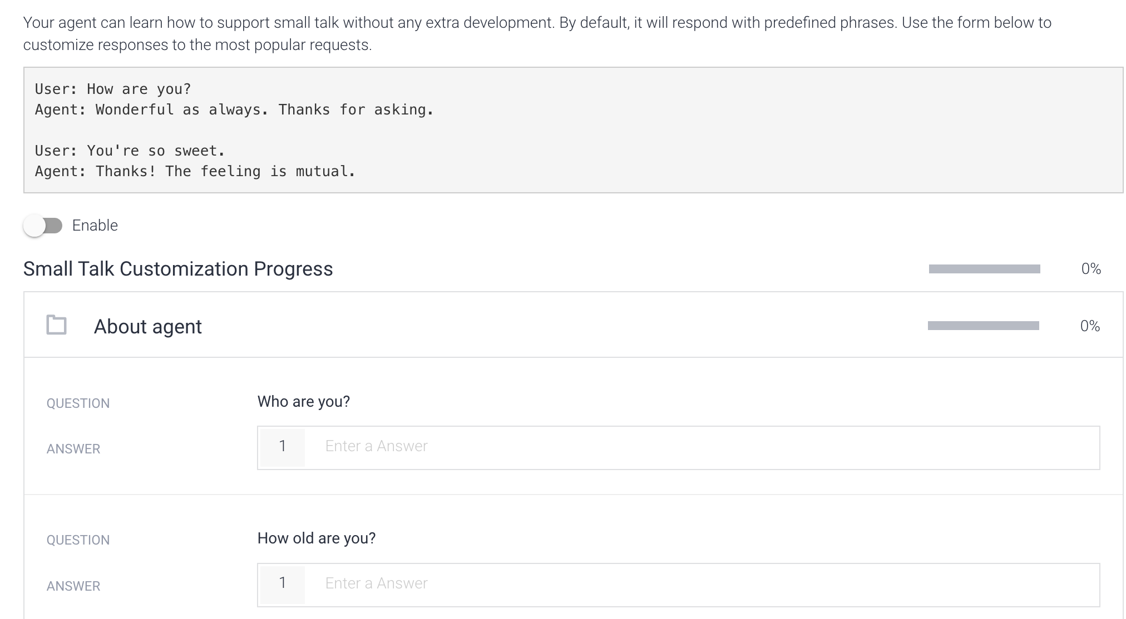
Prebuilt Agents
Small talk

Slide 43
Thanks

